Slide 1
Chapter 4
The Basics of Javascript
Programming the World Wide Web
Fourth edition
By Robert W. Sebesta

Slide 2
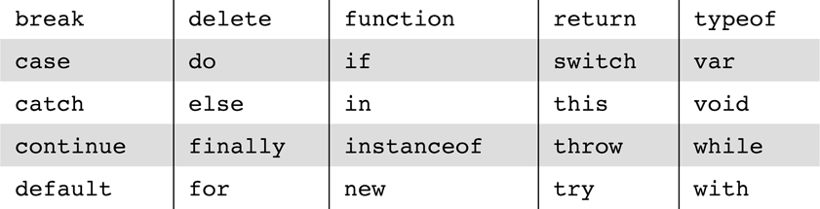
Table 4.1 JavaScript reserved words

Slide 3
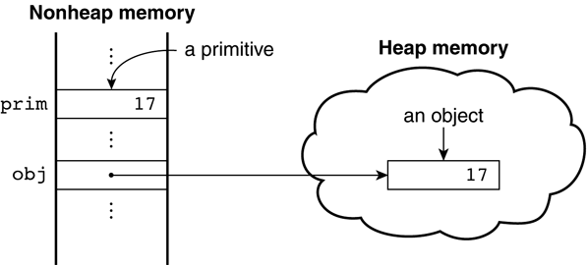
Figure 4.1 Primitives and objects

Slide 4
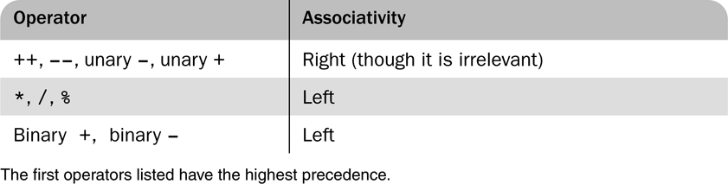
Table 4.2 Precedence and associativity of the numeric operators

Slide 5
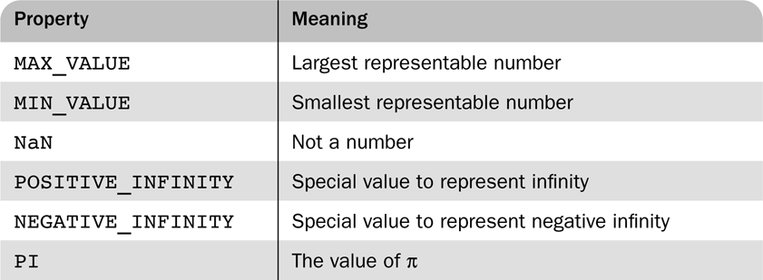
Table 4.3 Properties of Number

Slide 6
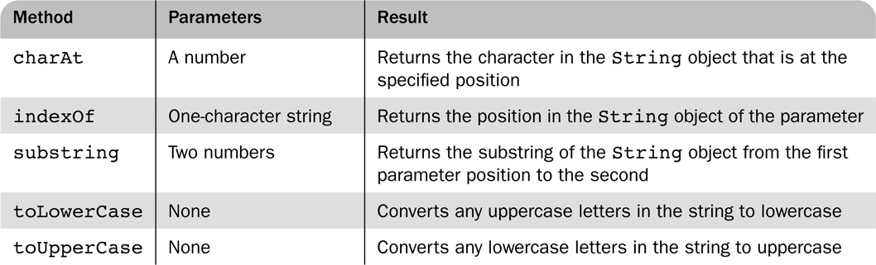
Table 4.4 String methods

Slide 7
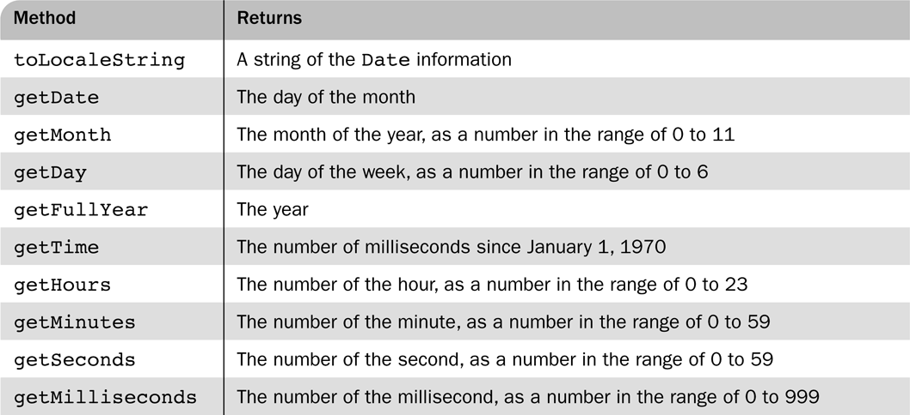
Table 4.5 Methods for the Date object

Slide 8

Figure 4.2 An example of the output of document.write

Slide 9
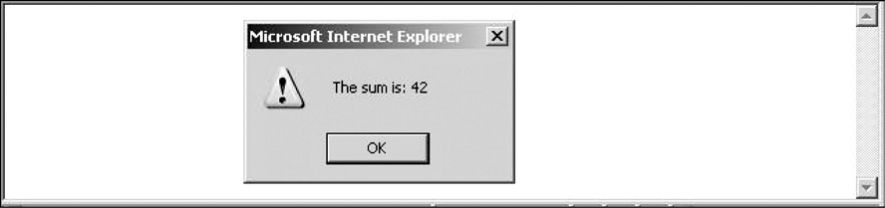
Figure 4.3 An example of the output of alert

Slide 10
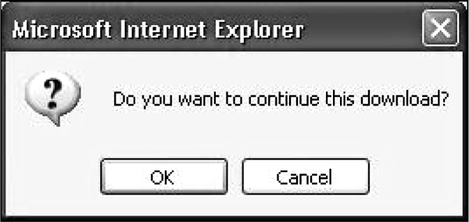
Figure 4.4 An example of the output of confirm

Slide 11
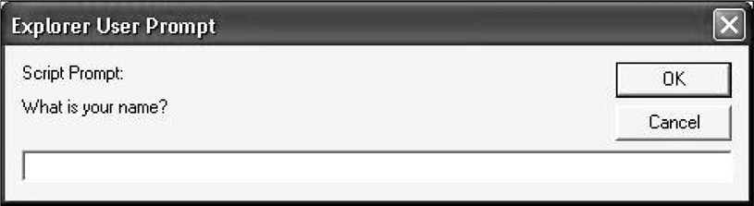
Figure 4.5 An example of the output of prompt

Slide 12
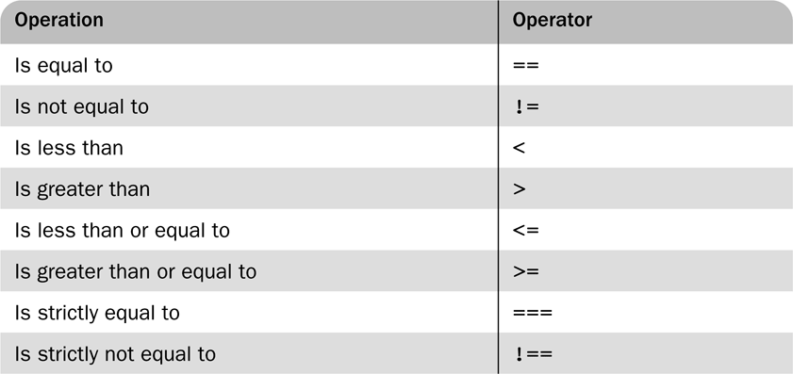
Table 4.6 Relational operators

Slide 13
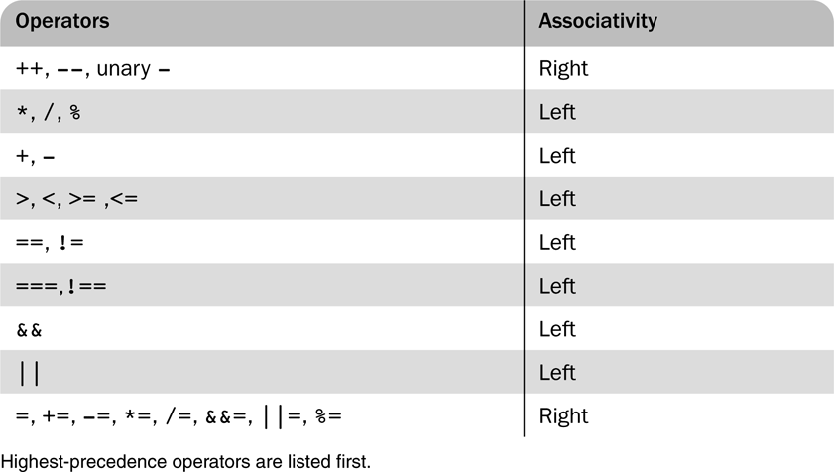
Table 4.7 Operator precedence and associativity

Slide 14
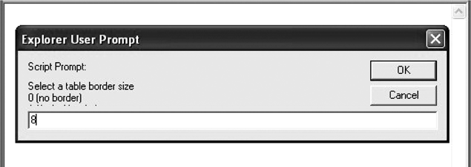
Figure 4.6 Dialog box from borders2.js

Slide 15
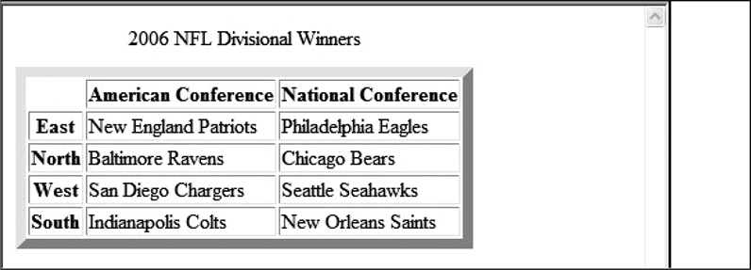
Figure 4.7 Display of borders2.js

Slide 16
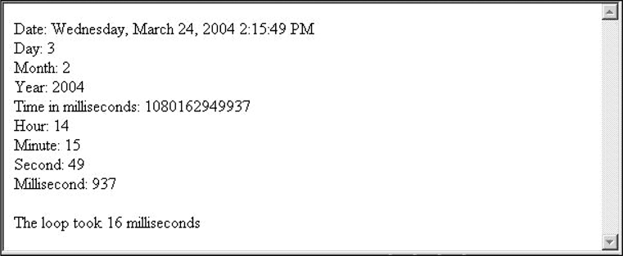
Figure 4.8 Display of date.js

Slide 17
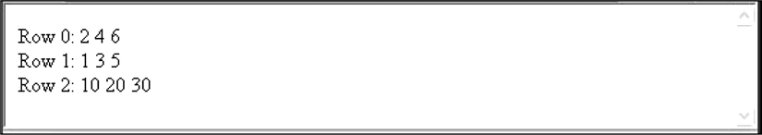
Figure 4.9 Display of nested_arrays.js

Slide 18
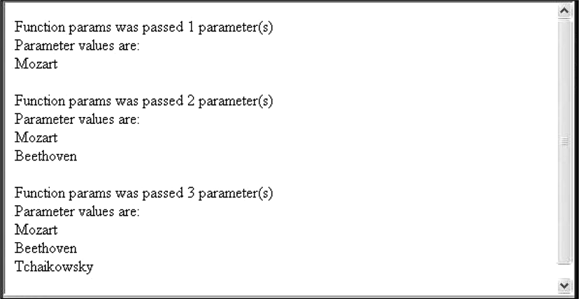
Figure 4.10 Display of params.js

Slide 19
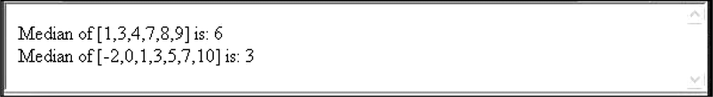
Figure 4.11 Display of medians.js

Slide 20
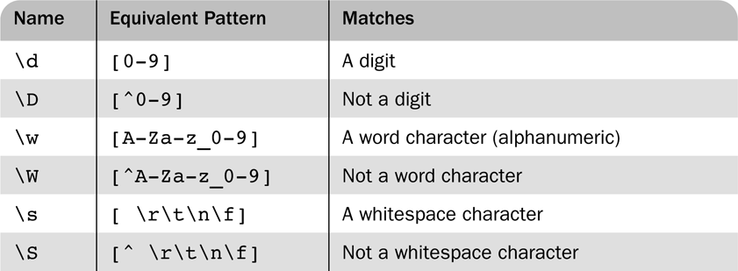
Table 4.8 Predefined character classes

Slide 21
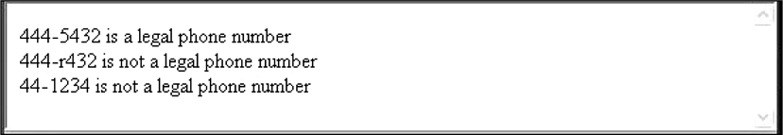
Figure 4.12 Display of forms_check.js

Slide 22
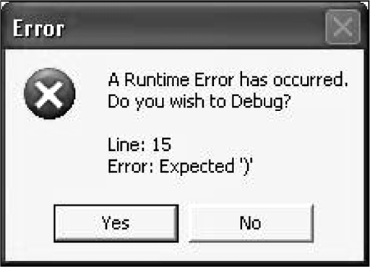
Figure 4.13 Display of debugdemo.js with Internet Explorer 7

Slide 23
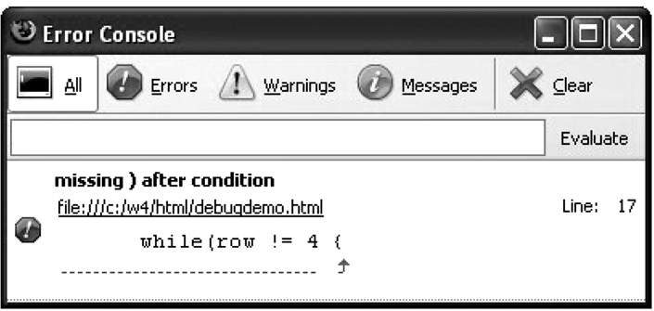
Figure 4.14 Display of the FireFox 2 error console

